Slide 1
SDN
Student:Ke-Chin Lee
Professor:Yen-Wen Chen
Date:2020/3/24

Slide 2
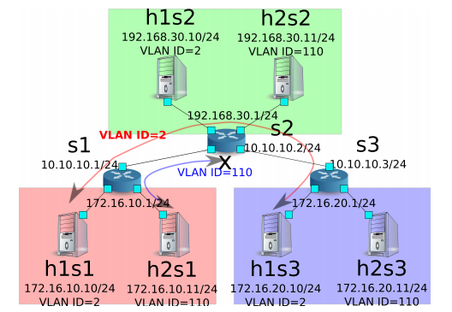
Architecture

Slide 3
IP address
Set the IP address on each router.

Slide 4
Default route
Set the default route for each router.

Slide 5
Result
Same domain & different VLAN ID
h1s1 ping h2s1

Slide 6
Result

Slide 7
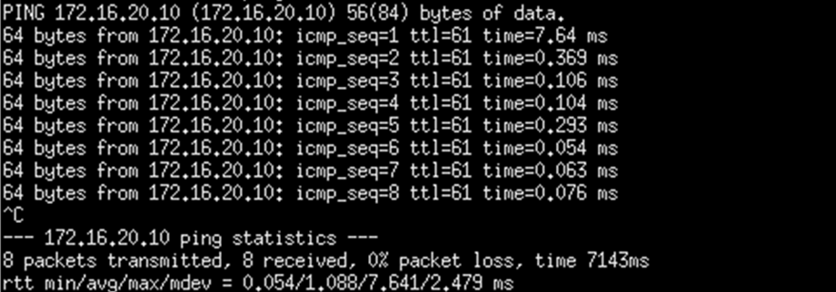
Result
Different domain & same VLAN ID
h1s1 ping h1s3

Slide 8
Result

Slide 9
Result
Different domain & same VLAN ID & no static route
h2s1 ping h2s3

Slide 10
Result

